Slide 1
CPE 133
FSM Review
FSM VHDL Behavioral Modeling Review
Unused States
FSM Design with Illegal State Recovery

Slide 2
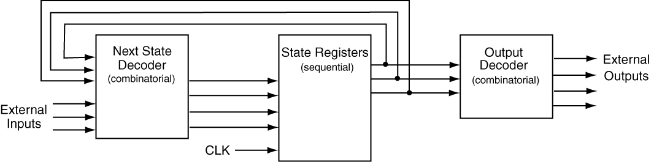
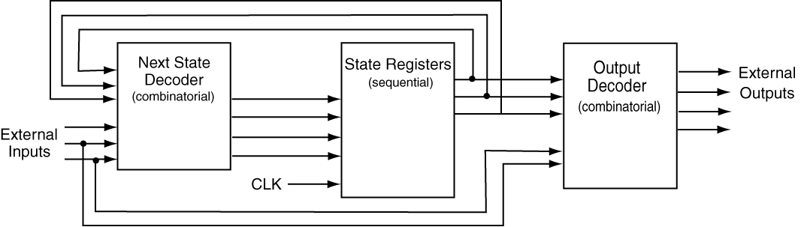
FSM Models: Two Types
Moore
Mealy

Slide 3
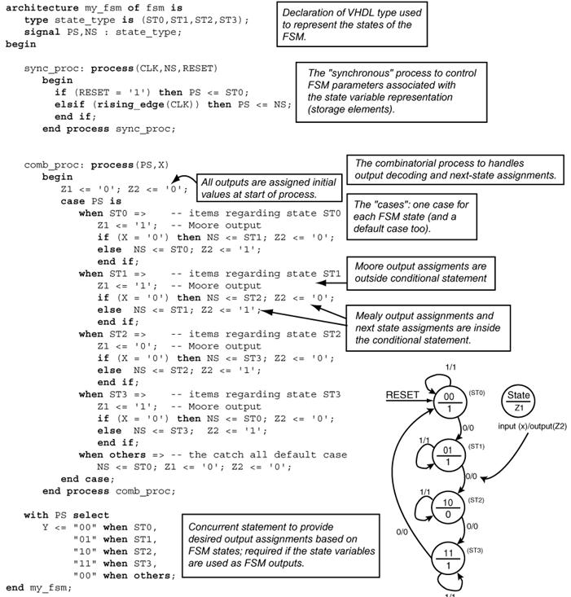
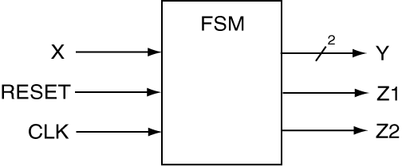
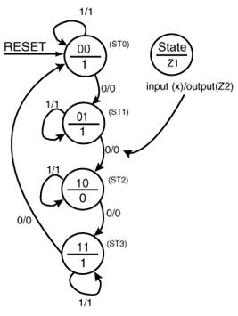
VHDL FSM Template

Slide 4
FSM Design
Example 14.2
Design a counter that counts in the following sequence: 0,2,3,1,0,2… . Use one T and one JK flip-flop for each of the state variables. Show a PS/NS table and state diagram that describes the FSM. Provide flip-flop excitation equations in reduced form and draw the final circuit.

Slide 5
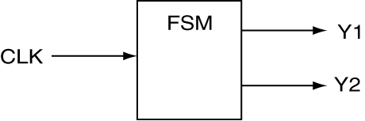
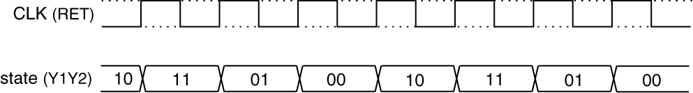
The Associated Timing Diagram
Block Diagram
Timing Diagram
Count Sequence = 0,2,3,1,0,2,…

Slide 6
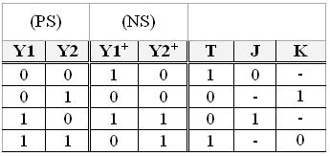
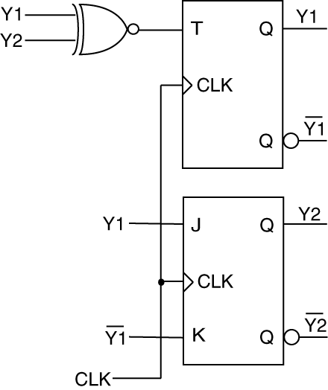
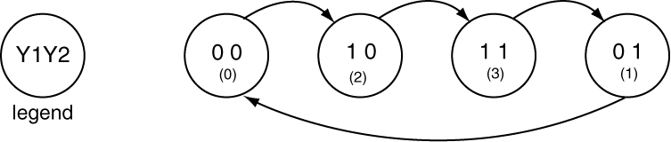
The Final Stuff
PS/NS Table
Circuit Diagram
State Diagram

Slide 7
Illegal State Recovery
Example 14‑8
Design a counter that counts in the following sequence: 0,5,7,3,6,0,5… Use only D flip-flops in your design. Make sure all unused states are directed to state 0. Draw the circuit as a character building exercise.
How many flip-flops are required?
How many states are used by counter?
What happens to the unused states?

Slide 8
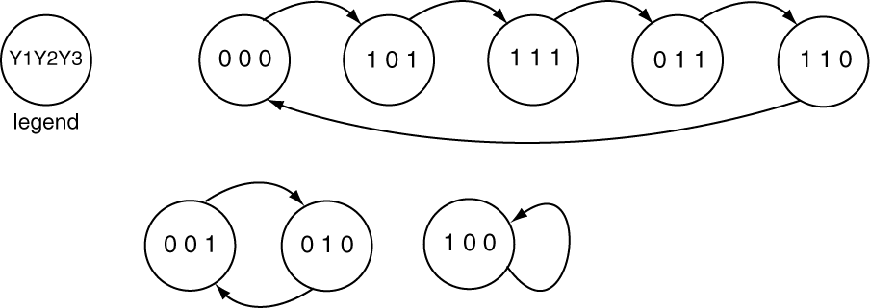
Hang States
0,5,7,3,6,0,5…

Slide 9
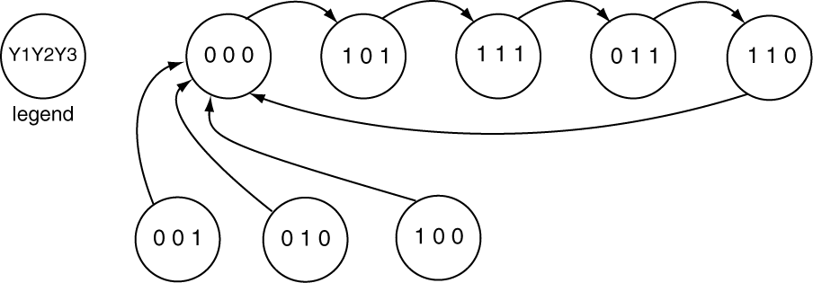
FSM with Illegal State Recovery

Slide 10
Example
Design a synchronous counter that repeats the given sequence indefinitely. Use a D flip-flop for the MSB (most significant bit), a T flip-flop for the middle bit, and a JK flop-flop for the LSB (least significant bit). Show a PS/NS table and state diagram that accounts for all states and the output variable Z. Provide output and excitation equations in reduced form. Count sequence = 0,2,4,7,3,0,2…
Direct the lowest unused count values to state 7 (count value 7)
A Moore output Z is ‘0’ only when the count is a number included in the count sequence
The counter has an asynchronous reset input that resets the counter to count 2

Slide 11
VHDL FSM Template

